Slide 1
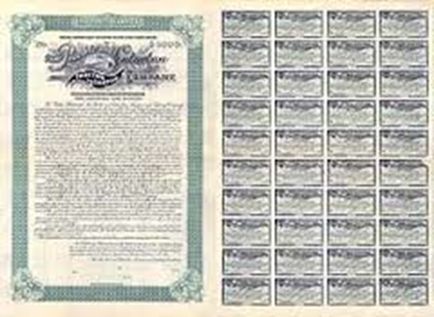
Lecture 11: Bond Valuation
HE Tai-Sen
FINANCIAL ECONOMICS

Slide 2
Bond Valuation
Outline
Bond Characteristics (14.1)
Bond Pricing (14.2)
Bond Yields (14.3)

Slide 3
Bond Valuation
Bond Characteristics
A bond is a security that is issued in connection with a borrowing arrangement. (The bond is the “IOU” of the borrower)
Par value (face value)
Coupon rate and coupon payments
Maturity date
Example: A 5-year maturity bond with par value of $1,000 makes semiannual coupon payments at a coupon rate of 10%.
Notes:
https://secure.fundsupermart.com/main/sgsInfo/sgsFactSheet.tpl

Slide 4
Bond Valuation
Bond Characteristics
Types of bonds
Treasury Bills (Zero-coupon bond)
Treasury Bonds and Notes
Corporate Bonds
Zero-coupon bond: Investors receive par value at maturity date but receive no interests until then. These bonds are issued at prices considerably lower than par value.
Notes:
https://secure.fundsupermart.com/main/sgsInfo/sgsFactSheet.tpl

Slide 5
Bond Valuation
Bond Pricing
Bond value
Notes:
P=C/(1+r)+C/(1+r)²+……+C/(1+r)^{T}+ Par/(1+r)^{T}
Using the formula for finite geometric series S_{n}= [a * (1-b^{n})] / (1-b)

Slide 6
Bond Valuation
Bond Pricing
Example 14.2: Please calculate the price of the 30-yr maturity bond with par value of $1,000, paying 8% coupon rate, and making semiannual coupon payments. Assume current interest rate is 4% per 6-month period (bond equivalent yield=4%*2=8%).

Slide 7
Bond Valuation
Bond Pricing
Example (continued): Please see Table 14.2. Bond prices at different interest rates (8% coupon bond, coupons paid semiannually)

Slide 8
Bond Valuation
Bond Pricing
Inverse relationship between price and interest rate.
Coupon rate, interest rate (r) and bond price (p)
If r = coupon rate, p = par value (selling at par value)
If r > coupon rate, p < par value (discount bonds)
If r < coupon rate, p > par value (premium bonds)
Keeping all other factors the same, the longer the maturity of the bond, the greater the sensitivity of price to fluctuations in the interest rate.

Slide 9
Bond Valuation
Bond Yield
Yield to Maturity (YTM): the interest rate that makes the present value of a bond’s payments equal to its price.
Example 14.3: Suppose an 8% coupon, 30-year bond is selling at 1276.76. What is the yield to maturity?

Slide 10
Bond Valuation
Bond Yield
=> r=3%, per half year.
How to annualize the semiannual yield?
Bond equivalent yield (BEY) is 3%*2=6% (the yield quoted in the newspapers)
The effective annual yield is (1+3%)²-1=6.09%

Slide 11
Bond Valuation
Bond Yield
Yield to Maturity (YTM) is often interpreted as a measure of the average rate of return that will be earned on a bond if it is bought now and held until maturity, assuming that all bond coupons can be reinvested at that yield.
The interest rate on a T-bond does change as market rates change. But once you purchase the instrument, the rate you get is locked in.
Current yield=Annual coupon payment/ Current bond price
Notes:
https://secure.fundsupermart.com/main/sgsInfo/sgsFactSheet.tpl

Slide 12
Bond Valuation
HW10
1. Using semiannual compounding, a 15-year zero coupon bond that has a par value of $1,000 and a required return of 8% would be priced at approximately ______. A. $308 B. $315 C. $464 D. $555
Notes:
Answer: A
1000/ (1.04^30) =308

Slide 13
Bond Valuation
HW10
2. Consider a 30-year bond paying an annual coupon of $80 and selling at par value of $1,000. The bond’s initial YTM is 8%.
(1) If the YTM remains at 8% over the year, what is the holding-period return? ______ %
(2) If the YTM falls below 8% and bond price increases to $1,050, what is the holding-period return? ______ %
Notes:
Since YTM=coupon rate, the bond is sold at par initially. (1000-1000+80)/1000=8%
[80+(1050-1000)]/1000=13%

Slide 14
Bond Valuation
HW10
3. Bonds of ABC Corporation with a par value of $1,000 sell for $960, mature in 5 years, and have a 7% annual coupon rate paid semiannually. Please calculate:
a. Current yield
b. Yield to maturity
c. Bond price in 3 years right after it makes the 6th coupon payment. (Assume the yield to maturity falls to 5%.)
Notes:
70/960=7.29%
$P=\frac{35}{1+r\%}+\frac{35}{{(1+r\%)}^{2}}+\frac{35}{{(1+r\%)}^{3}}+…\frac{35}{{(1+r\%)}^{10}}+\frac{1000}{{(1+r\%)}^{10}}=960$; r=4% => YTM=4%*2=8%
$P=\frac{35}{1+2.5\%}+\frac{35}{{(1+2.5\%)}^{2}}+\frac{35}{{(1+2.5\%)}^{3}}+\frac{1035}{{(1+2.5\%)}^{4}}=1037.6$

